Slide 1

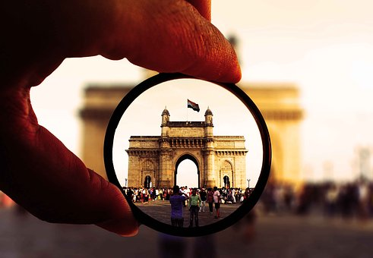


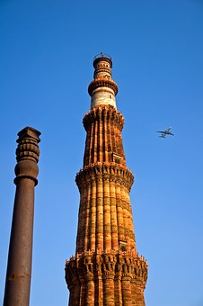
TCSへようこそ！ Welcome to TCS
Notes:
1
1

Slide 2
Customer Executives
Mr. Tomoji Tarutani - Executive Officer, IT Digital Promotion Dept, Compressor Division Sales Planning Dept, Engineering Dept.
Mr. Takenobu Watanabe - Office Manager, Assistant GM, Cyber Security Office, IT Digital Promotion Dept.
Mr. Yohei Yamamoto - Office Manager, Assistant GM, Group IT Infrastructure Office, IT Digital Promotion Dept.
TCS Japan
Mr. Taro Shibuya - CBO Delivery Head
Ms. Tomoko Wada - Client Partner
Mr. Kenji Hayakawa - Project Manager
TCS Team
Mr. Shashank Kulkarni – Service Delivery Head, JDC
Mr. Laxmikant Shaligram - Industry Leader, JDC
Mr. B Vijayakumar – Delivery Head, CBO, JDC
Mr. Vikas Choudhary – Lead, SSO & Cyber Security
Ms. Prerna Kashyap - Delivery Lead, Cyber Security Ms. Sangeetha Kumarasamy - Delivery Lead, IT Operations
Ms. Shilpa Vairagkar – Presales, JDC
Ms. Priya Vernekar - Interpreter, JDC
Mr. Avinash Muley – Visit Coordinator
Notes:
2

Slide 3
AGENDA
21st June 2023 (Wednesday) – S2 Boardroom
Start Time | Duration | End Time | Agenda | Presenter (s)/ Stories | Location
11:00 | 60 Mins | 12:00 | Airport to TCS SP Office
12:00 | 15 Mins | 12:15 | Reception & Security | TCS Members | Gate 2
12:15 | 45 Mins | 13:00 | Lunch |  | A1 Poolside
13:00 | 20 Mins | 13:20 | Toyota Industry Expectation in India visit | TICO Members | S2 Boardroom
13:20 | 10 Mins | 13:30 | Introduction of Visit Agenda/ Context Setting | Wada/ Shibuya | S2 Boardroom
13:30 | 20 Mins | 13:50 | JDC & JDM Overview and HR Best Practices | Shali | S2 Boardroom
13:50 | 45 Mins | 14:35 | AR/VR - IoT DE session | Chandrakant | S2 Boardroom (MS Teams)
14:35 | 30 Mins | 15:05 | GEC Overview | Adithya | S2 Boardroom (MS Teams)
15:05 | 30 Mins | 15:35 | Hikari Academy Floor Walk | Shali | S2 Ground floor
15:35 | 55 Mins | 16:30 | PRISM ODC Floor Walk | Unmesh/ Hayakawa/ PRISM team | S3 1st floor
16:30 | 40 Mins | 17:10 | End to End IT Integrated Operations Floor walk | Account team | S3 1st floor
17:10 | 40 Mins | 17:50 | Cyber Security Floor walk | Rahul | S3 Boardroom
17:50 | 10 Mins | 18:00 | Wrap up | Shibuya | S3 Boardroom
18:00 | Depart for Dinner at 18:00 |  |  |  | Taj Vivanta (Vandaag)
Notes:
3

Slide 4


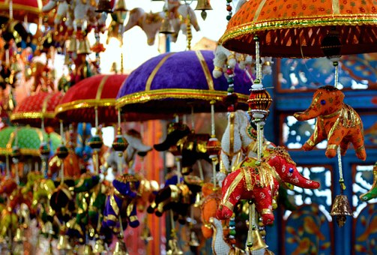
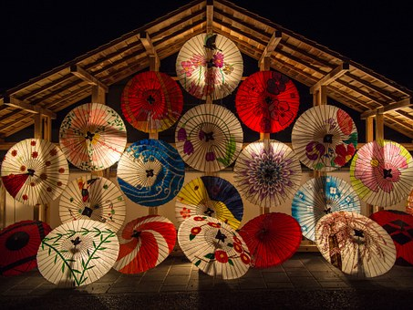


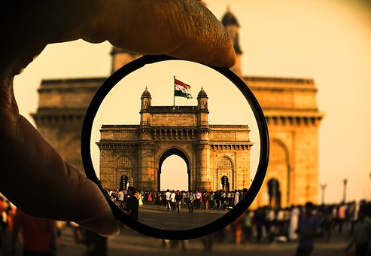
ありがとうございました

